Slide 1
Explainability in LLMs

Slide 2
TABLE OF CONTENTS
01
02
Motivation
Literature review
03
04
Approach used
Demonstration
Main idea & Results
Related methods
Summary of systems
Built system

Slide 3
01
Motivation

Slide 4
Motivation
Users need to understand model decisions, especially in high-stakes domains (e.g., healthcare, legal, finance).
Traditional ML models (e.g., trees, logistic regression) have established explainability methods, but LLMs require different approaches.
LLMs are rapidly complementing and even replacing traditional models, making it crucial to understand how they reach decisions.
Prompting strategies like CoT and ReAct enhance both performance and explainability.
Explainability builds trust and ensures reliable outcomes. Without clear reasoning behind LLM outputs, users may struggle to trust the model’s decisions, particularly in sensitive contexts.
Poor explainability can lead to poor performance. LLMs often perform better when prompted in ways that reveal their reasoning process, improving accuracy and robustness.

Slide 5
02
Literature Review

Slide 6
Literature review
SHAP
LIME
Less popular tools (ELI5)
Feature importance, explaining individual predictions, and model debugging
Intuitive for explaining tabular, text, and image data
Quick model inspection, feature weight visualization, and debugging

Slide 7
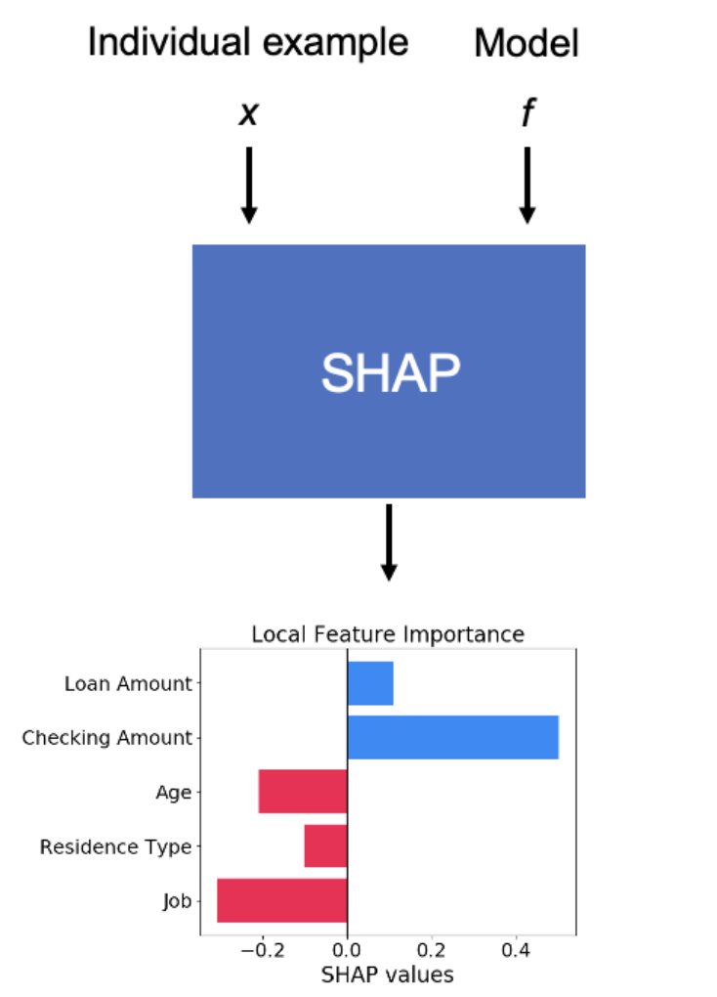
SHAP

Slide 8
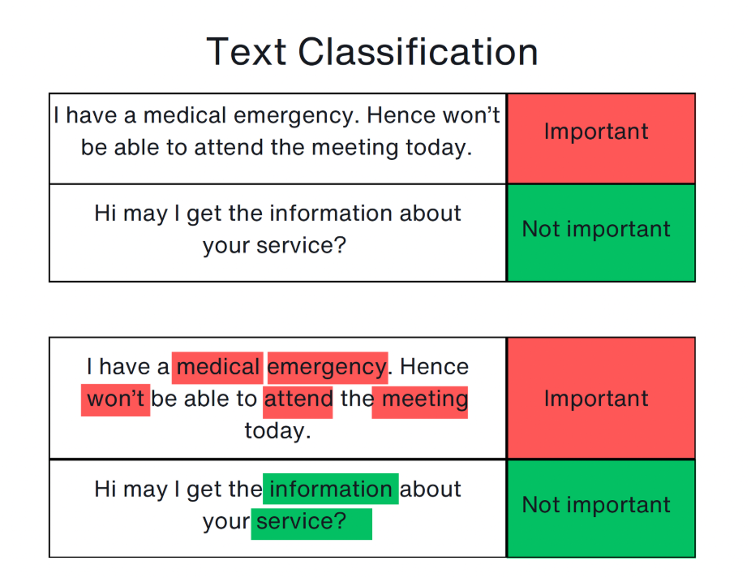
LIME

Slide 9
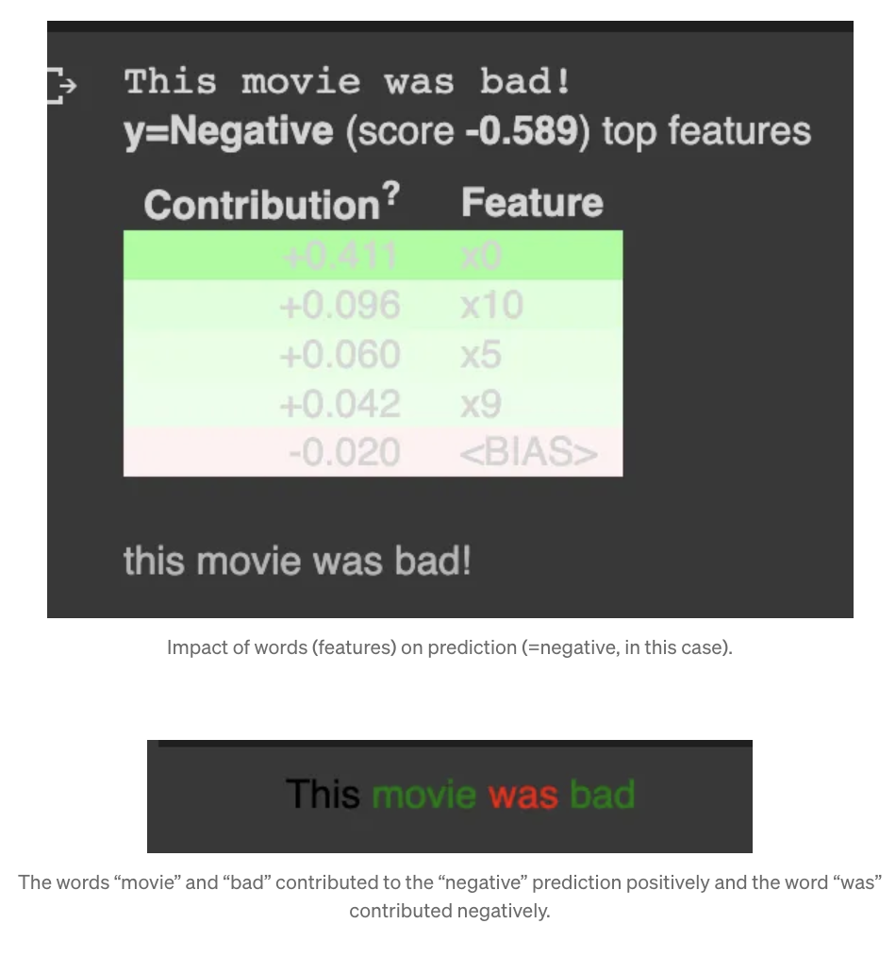
ELI5

Slide 10
03
Approach Used

Slide 11
Methods
Method | DESCRIPTION
Zero shot & Few shot prompting | Zero shot : You provide the model with a prompt and expect it to generate the correct response without any examples. Few-shot is similar, but with examples.
Chain of Thought prompting | CoT encourages the model to explain its reasoning step by step, improving performance in complex reasoning tasks.
Meta-prompting | In meta-prompting, the prompt itself is designed to influence the structure or style of the model’s response.
Self-consistency prompting | Generates multiple solutions to a given problem, then selects the most common or coherent result.
Generated Knowledge prompting | This technique instructs the model to first generate background knowledge or information before answering the main query.
Prompt chaining | Prompt chaining involves splitting complex tasks into multiple sequential prompts, where the output of one prompt becomes the input for the next.
RAG | RAG combines a language model with a retrieval system that fetches relevant documents or facts from an external database before generating a response.
ReAct | ReAct combines reasoning with actions, where the model iteratively reflects on information, interacts with tools or APIs, and refines its response.

Slide 12
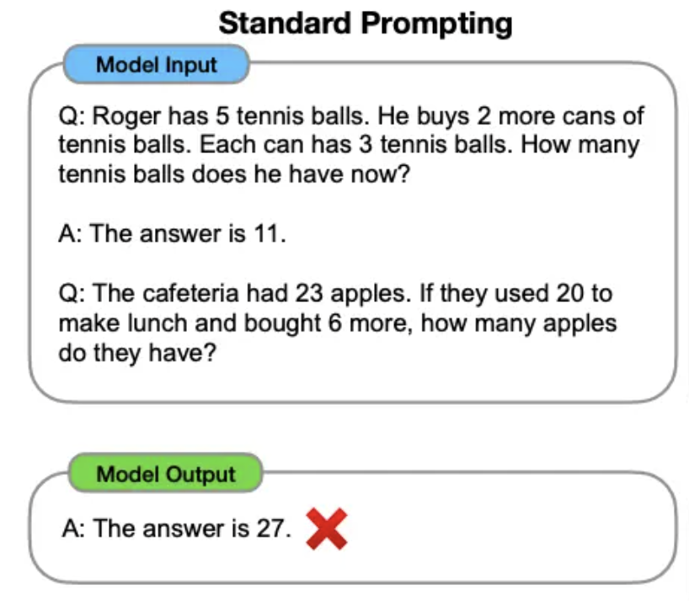
Zero-shot & Few Shot

Slide 13
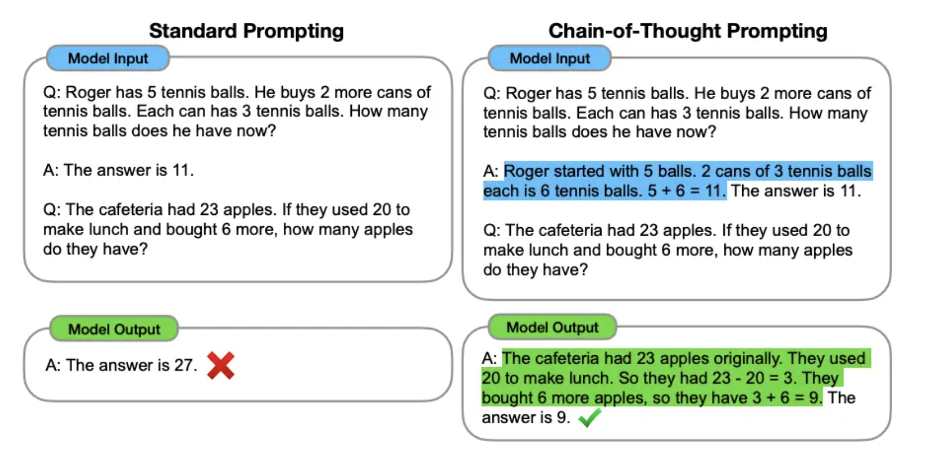
Chain of Thought prompting

Slide 14
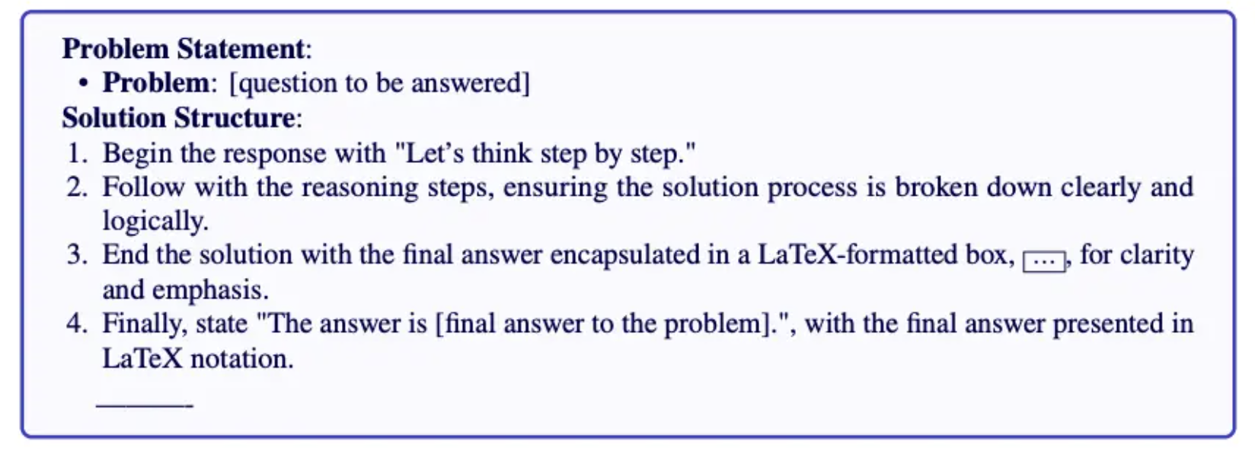
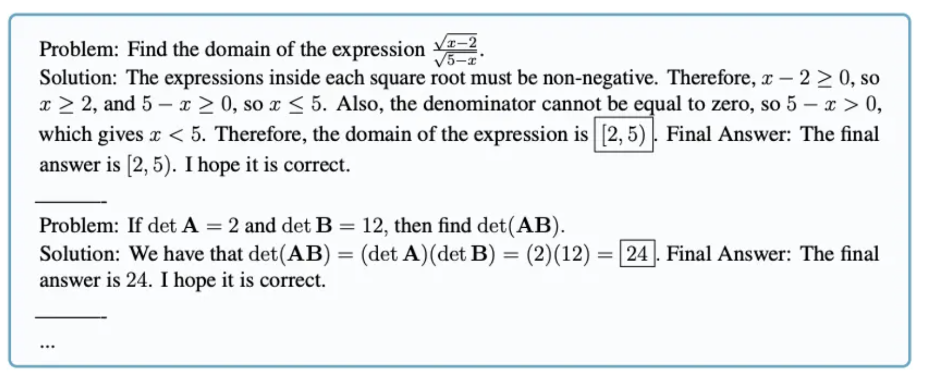
Meta-prompting
Focuses on the structural and syntactical aspects of tasks and problems rather than their specific content details

Slide 15
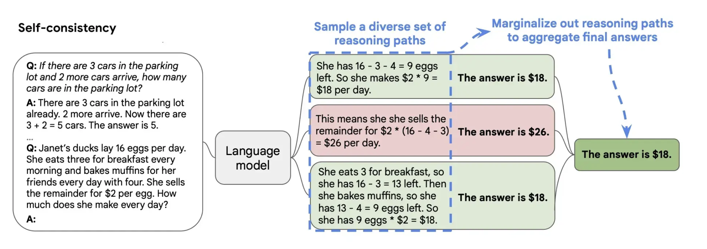
Self-consistency prompting
Generates multiple solutions with different thought processes and selects answer with the most votes

Slide 16
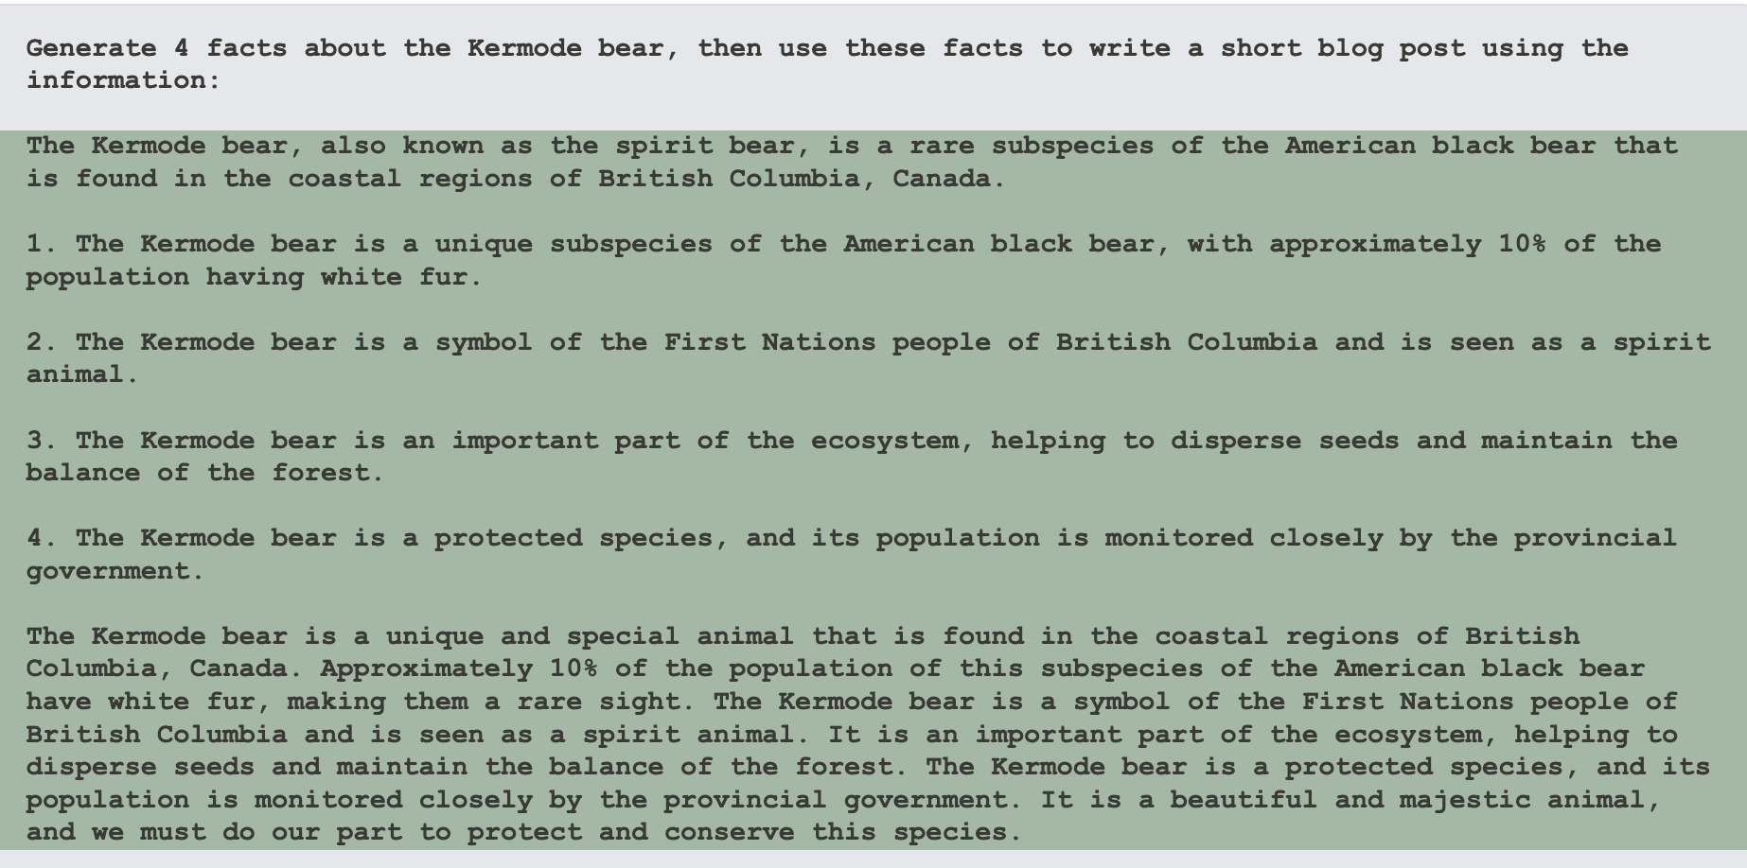
Generated-knowledge prompting

Slide 17
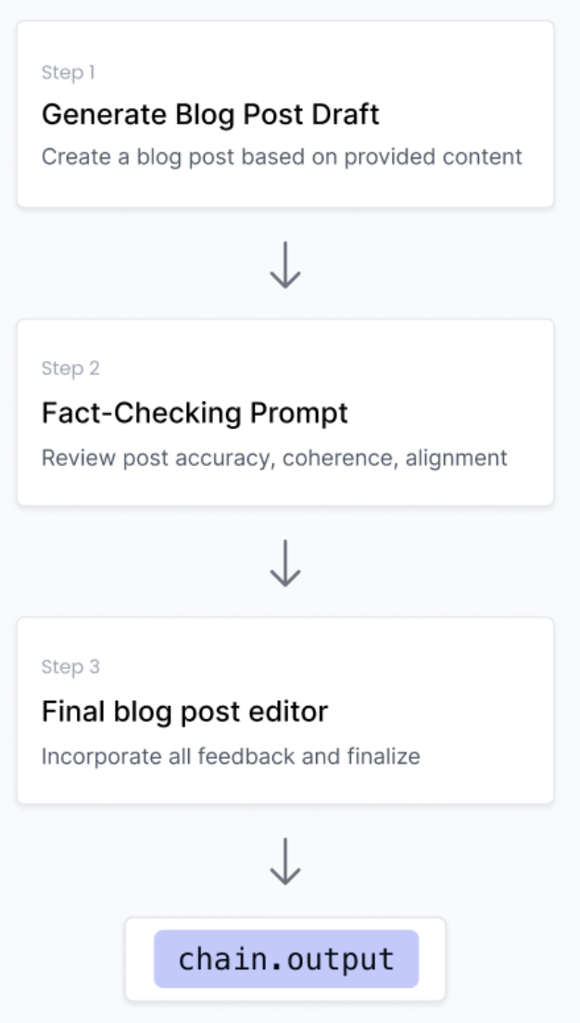
Prompt chaining

Slide 18
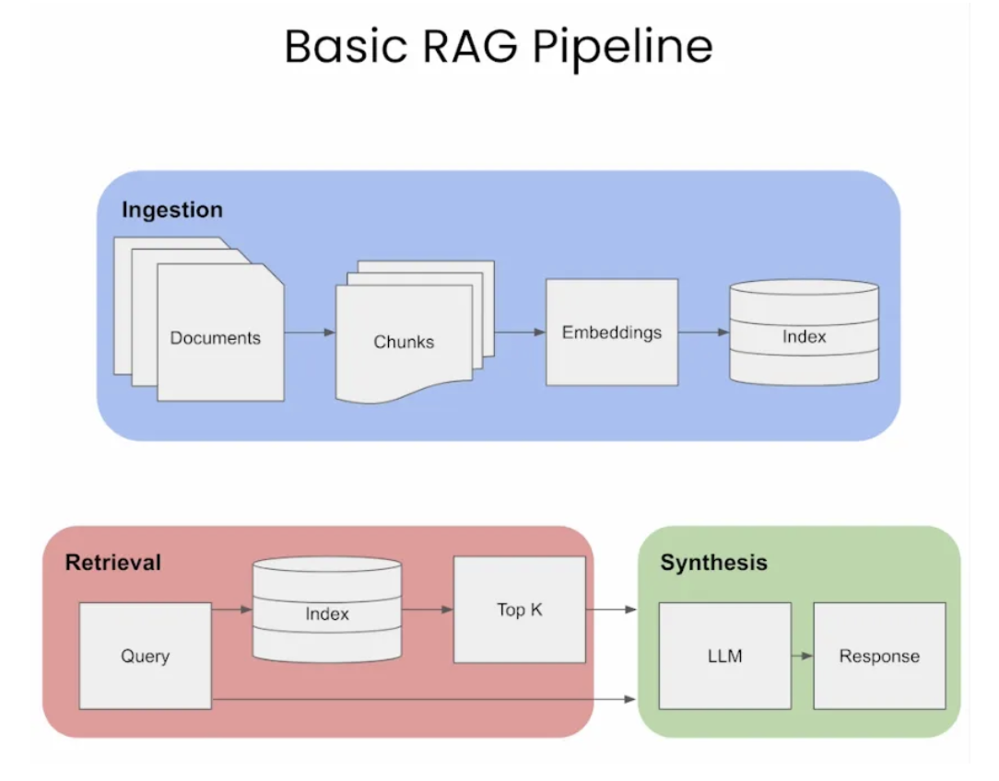
RAG

Slide 19
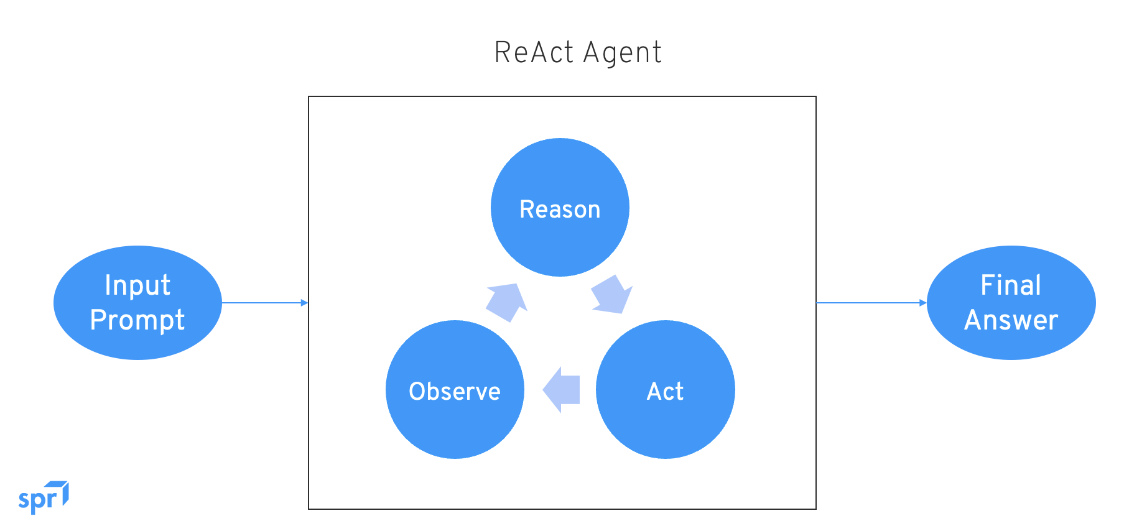
ReAct

Slide 20
04
Demonstration

Slide 21

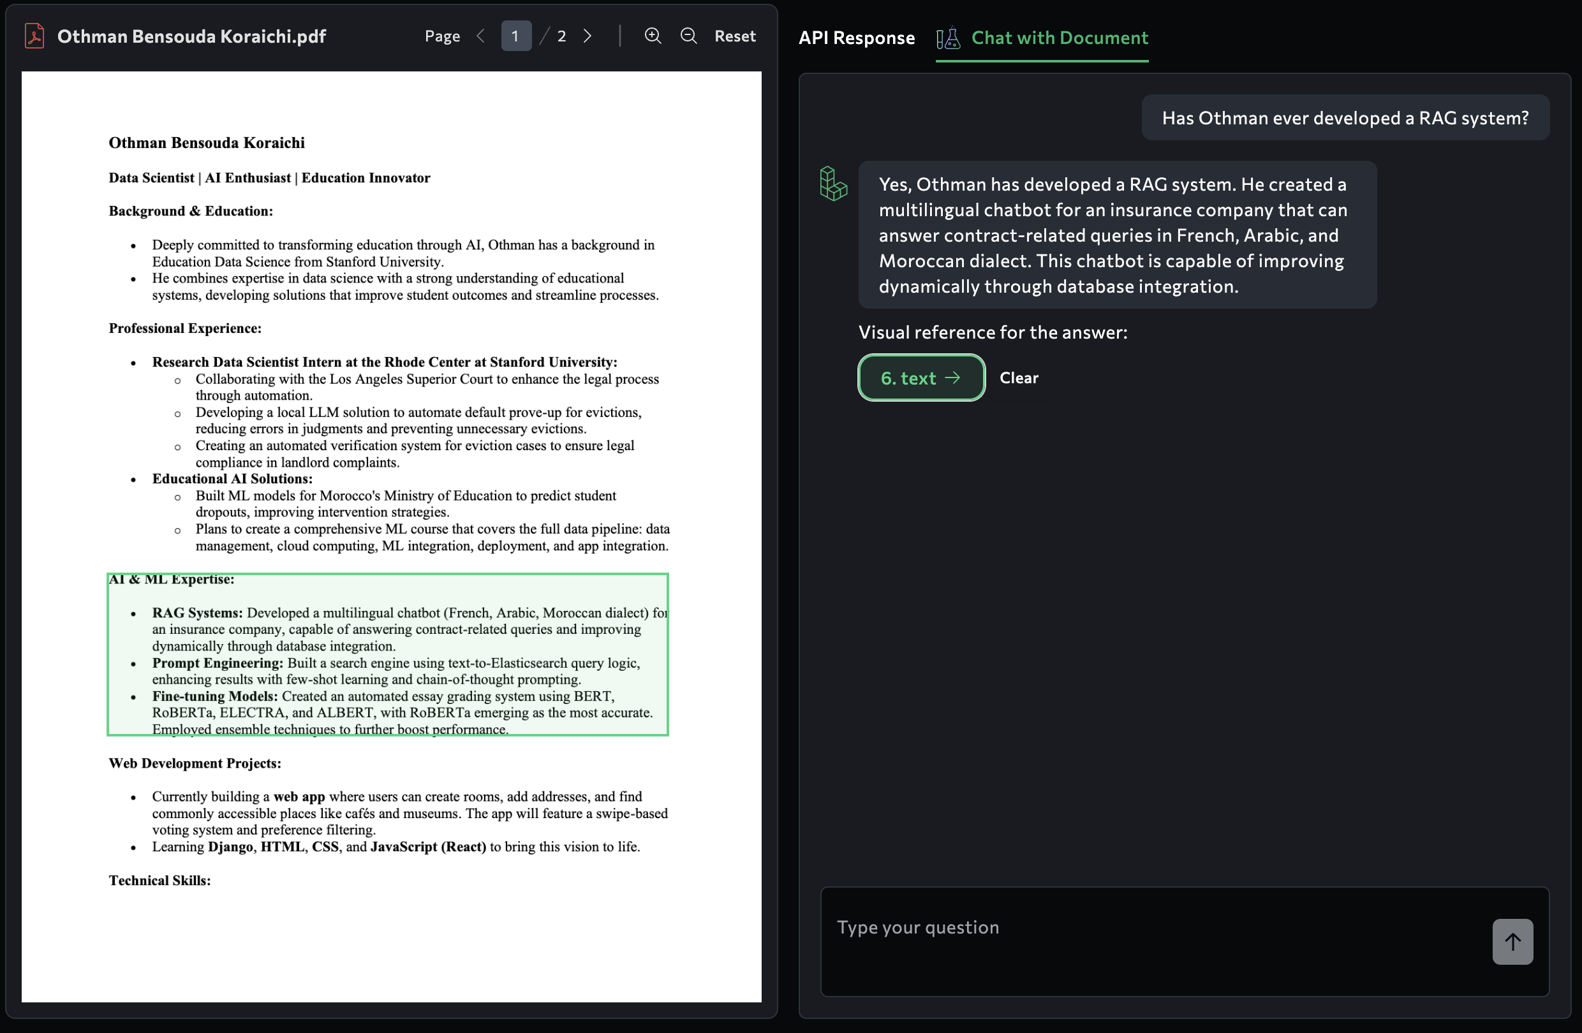
DEMO (RAG)

Slide 22
DEMO (RAG)

Slide 23
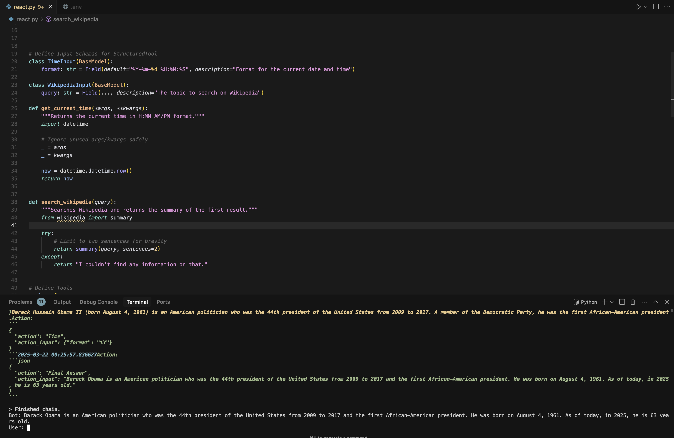
DEMO (ReAct)

Slide 24
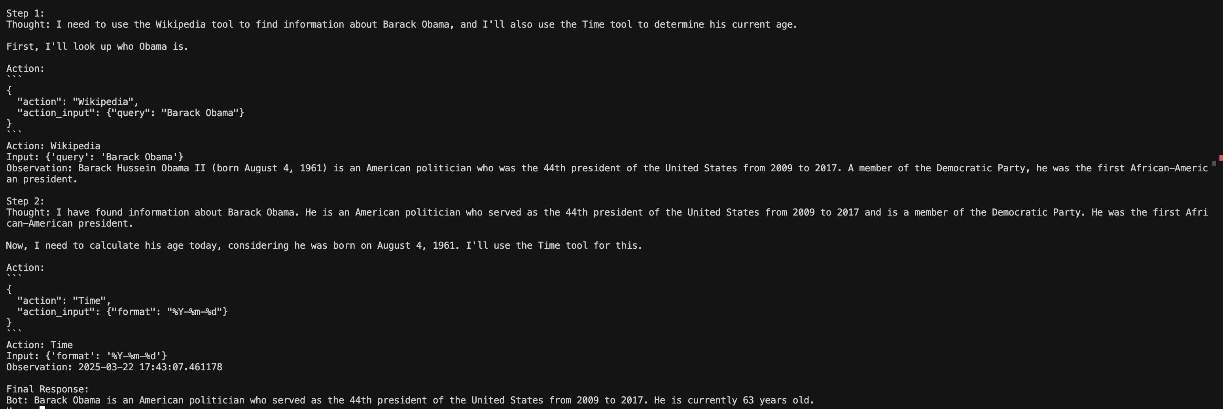
DEMO (ReAct)

Slide 25
References
SHAP : Lundberg, S. M., & Lee, S.-I. (2017). A Unified Approach to Interpreting Model Predictions. Advances in Neural Information Processing Systems, 30.
LIME : Ribeiro, M. T., Singh, S., & Guestrin, C. (2016). "Why Should I Trust You?": Explaining the Predictions of Any Classifier. Proceedings of the 22nd ACM SIGKDD International Conference on Knowledge Discovery and Data Mining (KDD '16), 1135-1144. https://doi
ELI5 : https://eli5.readthedocs.io/en/latest/overview.html
Few-shot prompting : Brown et al. (2020). Language Models are Few-Shot Learners. Advances in Neural Information Processing Systems, 33, 1877-1901.
CoT : Wei et al. (2022). Chain-of-thought prompting elicits reasoning in large language models. In Proceedings of the 36th International Conference on Neural Information Processing Systems (NeurIPS 2022) (Article No. 1800, pp. 24824–24837).
Meta-prompting : Zhang, Y., Yuan, Y., & Yao, A. C.-C. (2023). Meta Prompting for AI Systems. arXiv preprint arXiv:2311.11482. https://doi.org/10.48550/arXiv.2311.11482
Self-consistency : Wang, X., Wei, J., Schuurmans, D., Le, Q., Chi, E., & Zhou, D. (2022). Self-Consistency Improves Chain of Thought Reasoning in Language Models. arXiv preprint arXiv:2203.11171. https://doi.org/10.48550/arXiv.2203.11171
Generated-Knowldege prompting : Liu, J., Liu, A., Lu, X., Welleck, S., West, P., Le Bras, R., Choi, Y., & Hajishirzi, H. (2022). Generated Knowledge Prompting for Commonsense Reasoning. arXiv preprint arXiv:2110.08387. https://doi.org/10.48550/arXiv.2110.08387
Prompt chaining : Sun, S., Yuan, R., Cao, Z., Li, W., & Liu, P. (2024). Prompt Chaining or Stepwise Prompt? Refinement in Text Summarization. arXiv preprint arXiv:2406.00507. https://doi.org/10.48550/arXiv.2406.00507
RAG : Lewis, P., Perez, E., Piktus, A., Petroni, F., Karpukhin, V., Goyal, N., Küttler, H., Lewis, M., Yih, W., Rocktäschel, T., Riedel, S., & Kiela, D. (2020). Retrieval-Augmented Generation for Knowledge-Intensive NLP Tasks. arXiv preprint arXiv:2005.11401. h
ReAct : Yao, S., Zhao, J., Yu, D., Du, N., Shafran, I., Narasimhan, K., & Cao, Y. (2022). ReAct: Synergizing Reasoning and Acting in Language Models. arXiv preprint arXiv:2210.03629. https://doi.org/10.48550/arXiv.2210.03629
Prompts : https://www.promptingguide.ai/techniques/knowledge

